Slide 1


DESIGNS
CQU LAB EQUIPMENT SOURCING

Slide 2
TEAM MEMBERS
S.NO | STUDENT NAME | STUDENT ID
01 | ADARSHA MANI LAMICHHANE | 12140071
02 | JAVAGAL SRINATH NARAYANAN | 12131213
03 | BANDANA KAPALI | 12127043
04 | MARUF SIDDIQUE | 12132167

Slide 3

Project Brief
CQU lab management system is an application build for the staffs and student to quickly find lab equipment available in all the campuses. Lab management system offers a set of key features that will support a modern laboratory operation.
CQU lab management system will set the key features that support a modern lab operation like data tracking support, flexible architecture and smart data exchange interfaces that will support its use in everyday regulated environment.

Slide 4
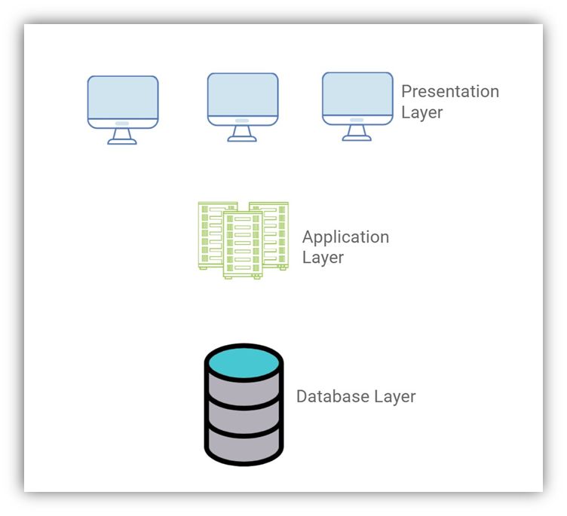
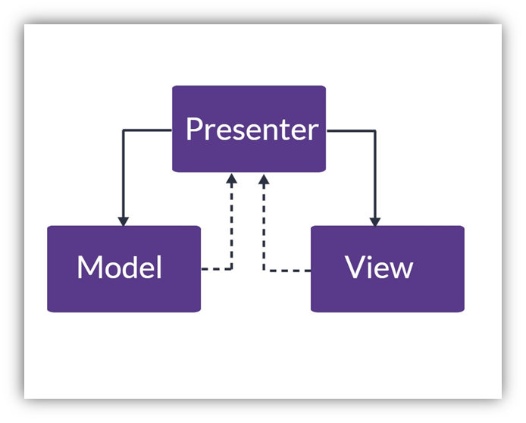
Software Architecture
N Tier Architecture
MVP pattern

Slide 5
WHAT WE GOING TO SEE IN THIS PRESENTATION
UML diagrams
Behaviour modelling
User Interface prototype

Slide 6
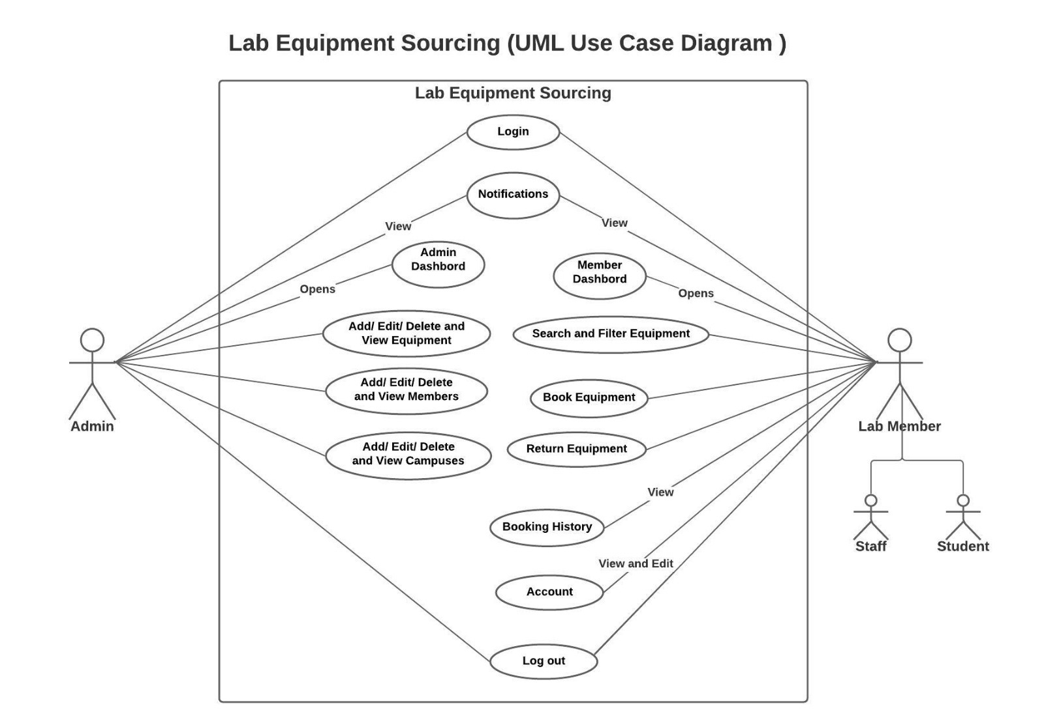
UML – USE CASE DIAGRAM

Slide 7
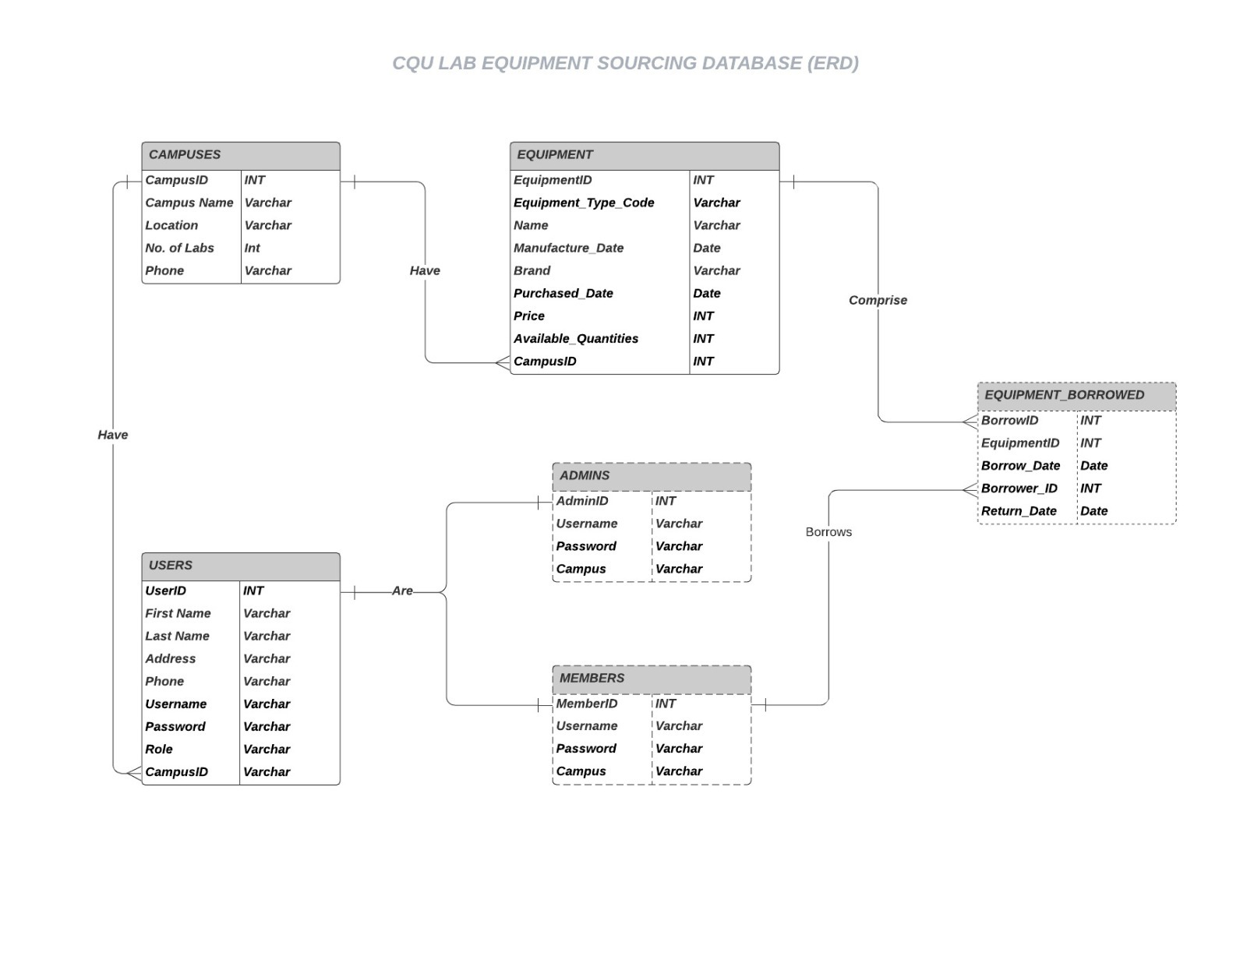
CQU LAB – EQUIPMENT SOURCING DATABASE

Slide 8
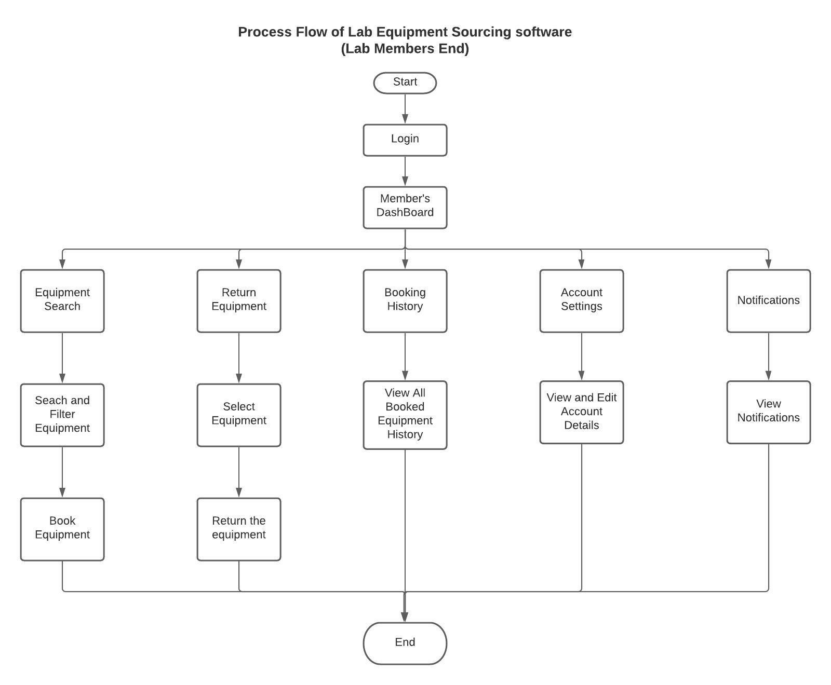
PROCESS FLOW DIAGRAM – LAB MEMBER END

Slide 9
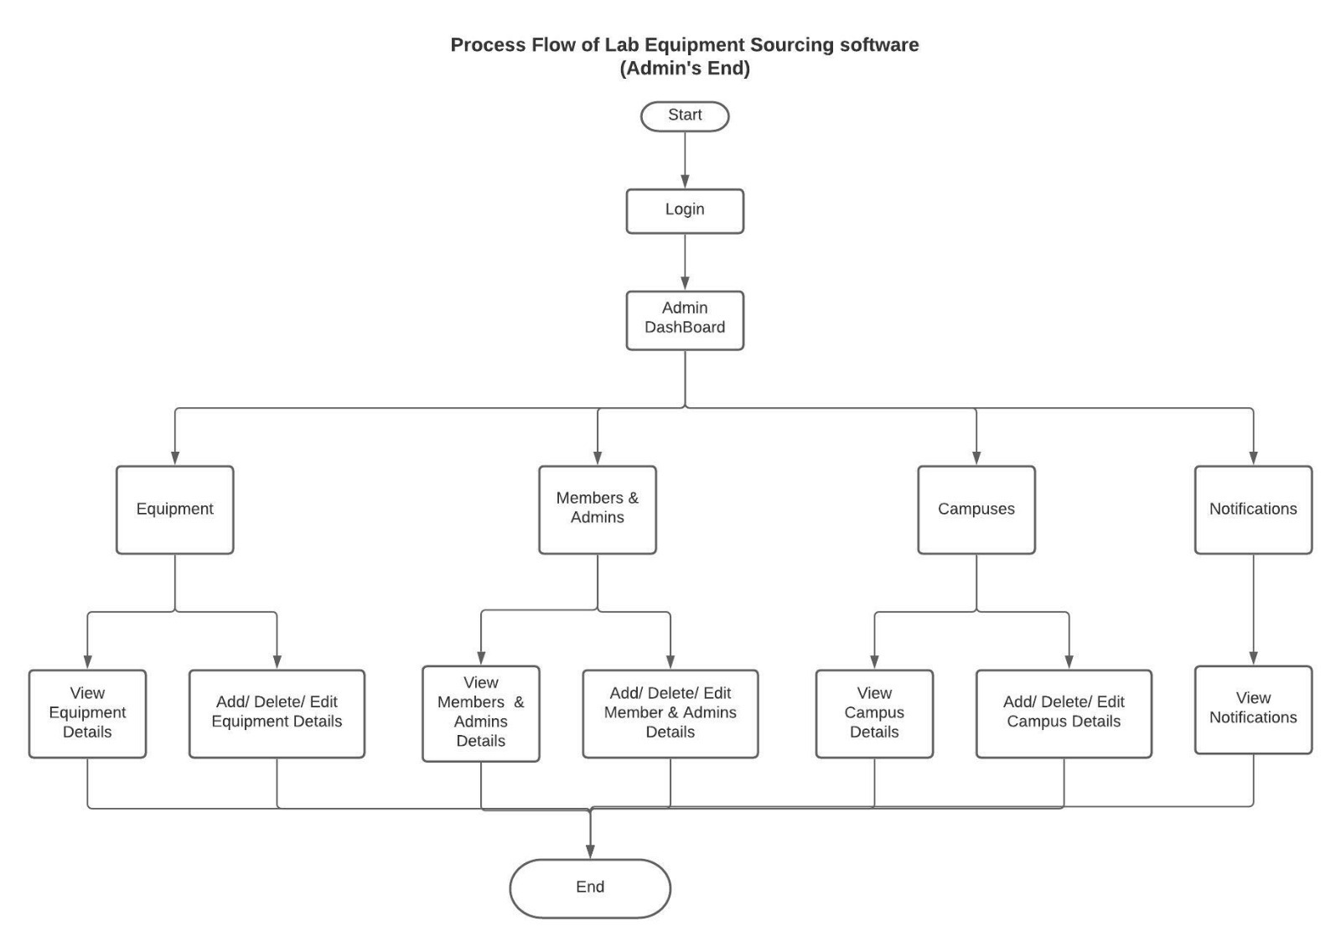
PROCESS FLOW DIAGRAM – ADMIN END

Slide 10
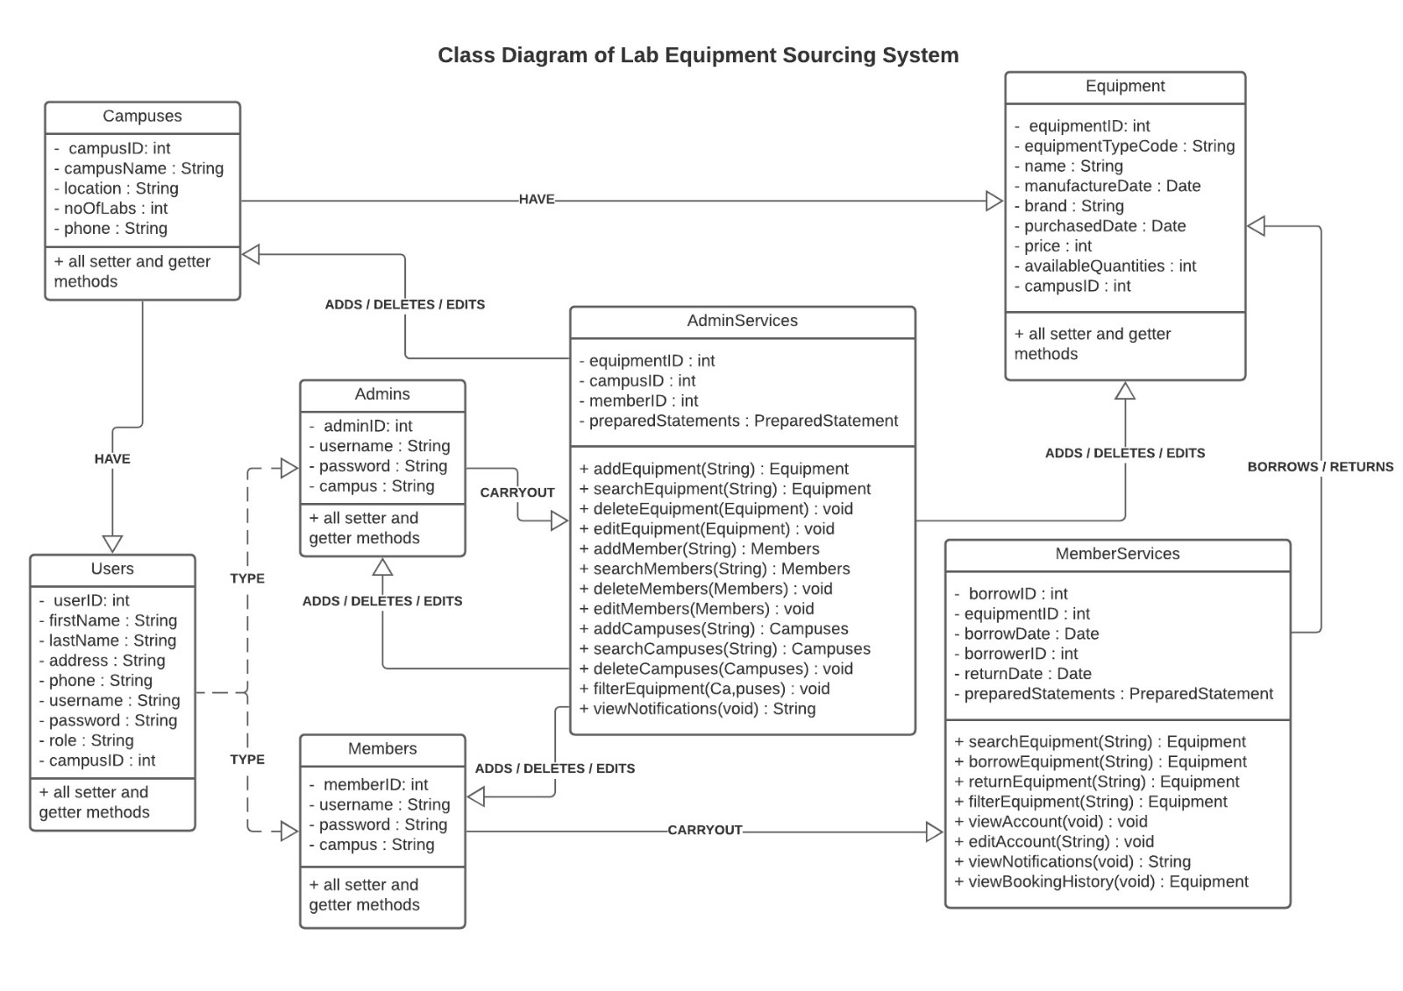
UML CLASS DIAGRAM

Slide 11
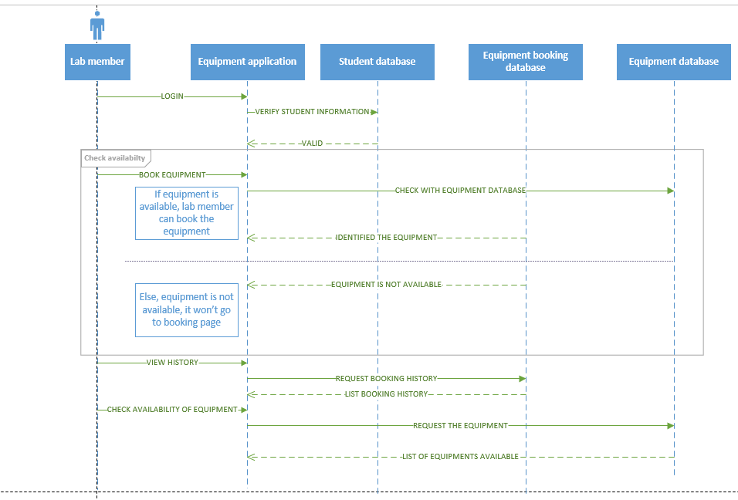
SEQUENCE DIAGRAM – STUDENT PAGE

Slide 12
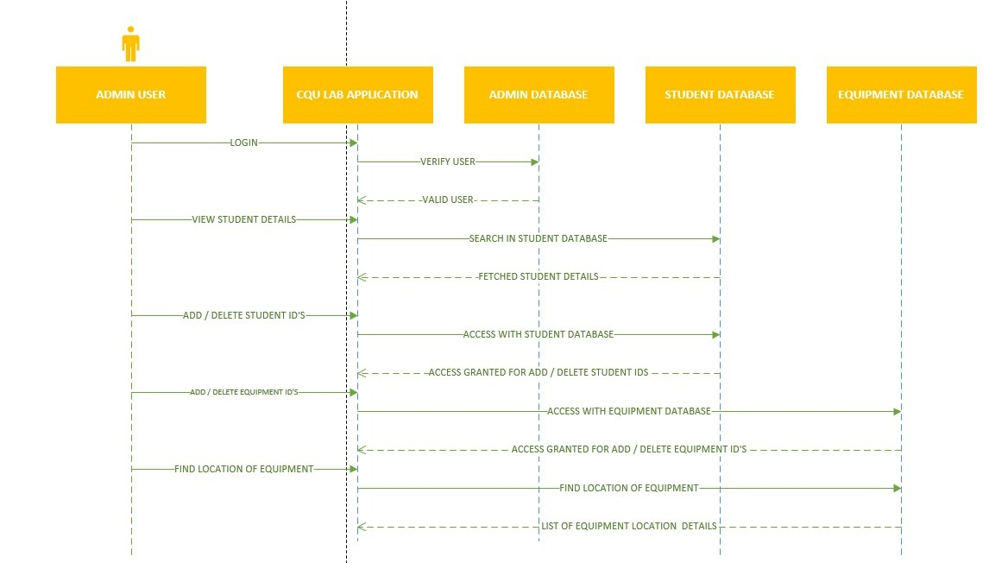
SEQUENCE DIAGRAM – ADMIN PAGE

Slide 13
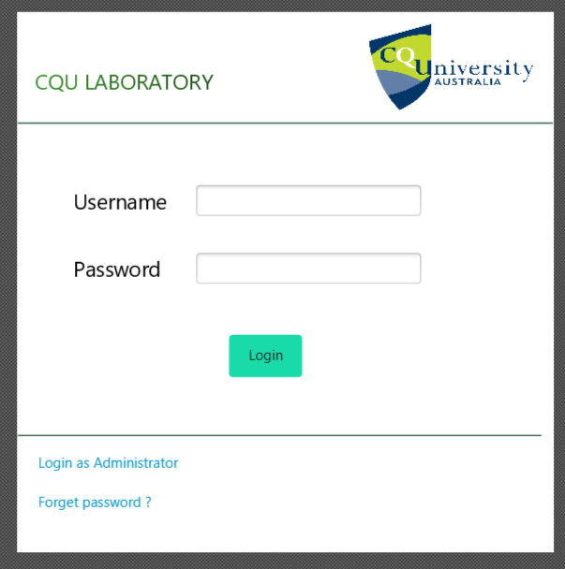
USER INTERFACE DESIGN – LOGIN SCREEN

Slide 14
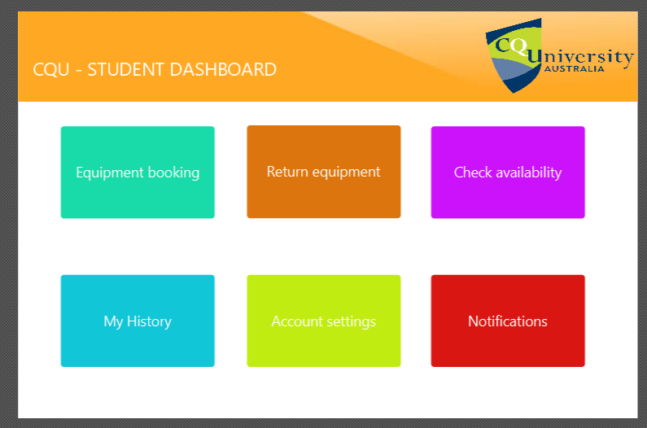
USER INTERFACE DESIGN – STUDENT DASHBOARD

Slide 15
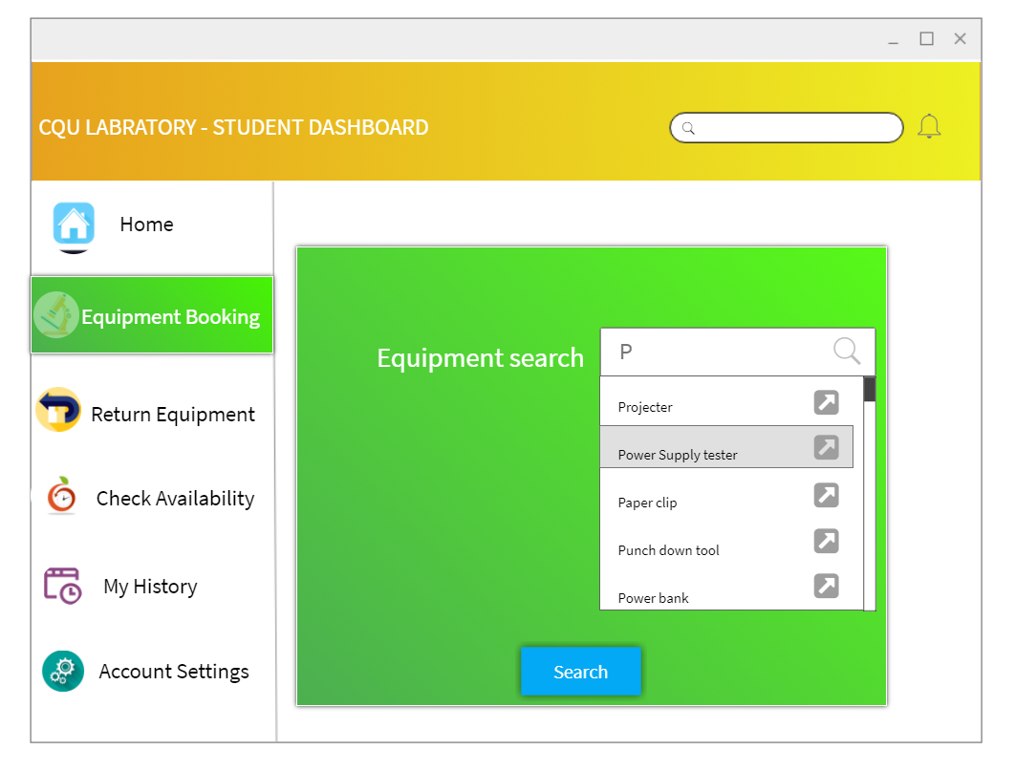
USER INTERFACE DESIGN – EQUIPMENT SEARCH WINDOW

Slide 16
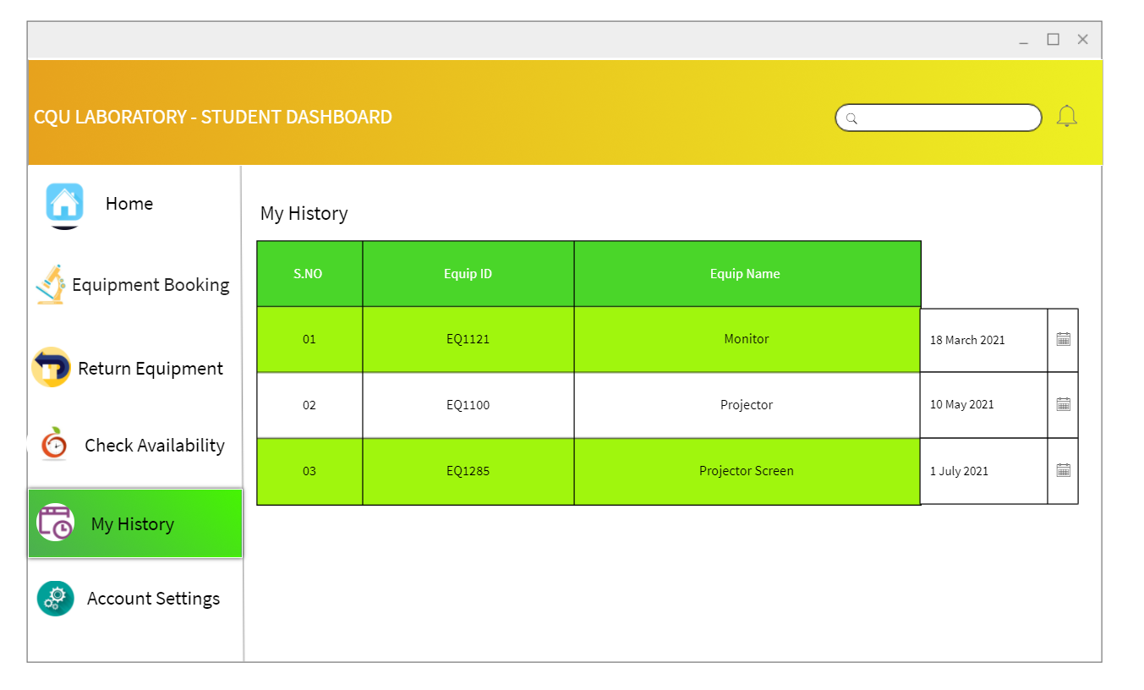
USER INTERFACE DESIGN – MY HISTORY

Slide 17
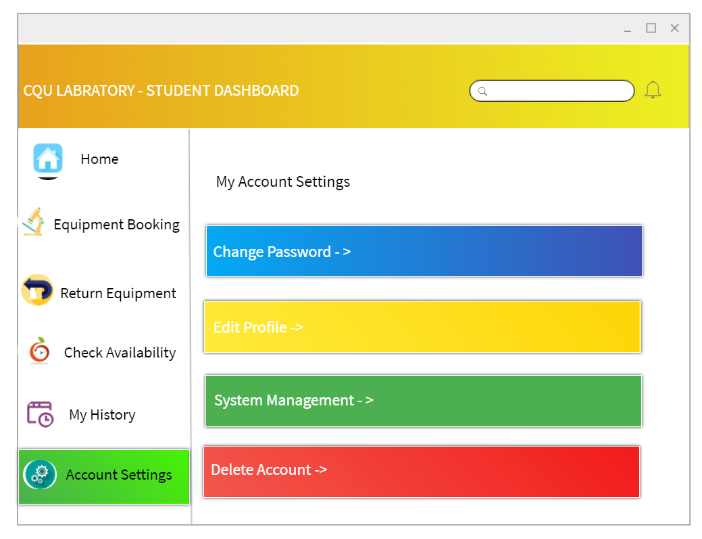
USER INTERFACE DESIGN – MY SETTINGS

Slide 18
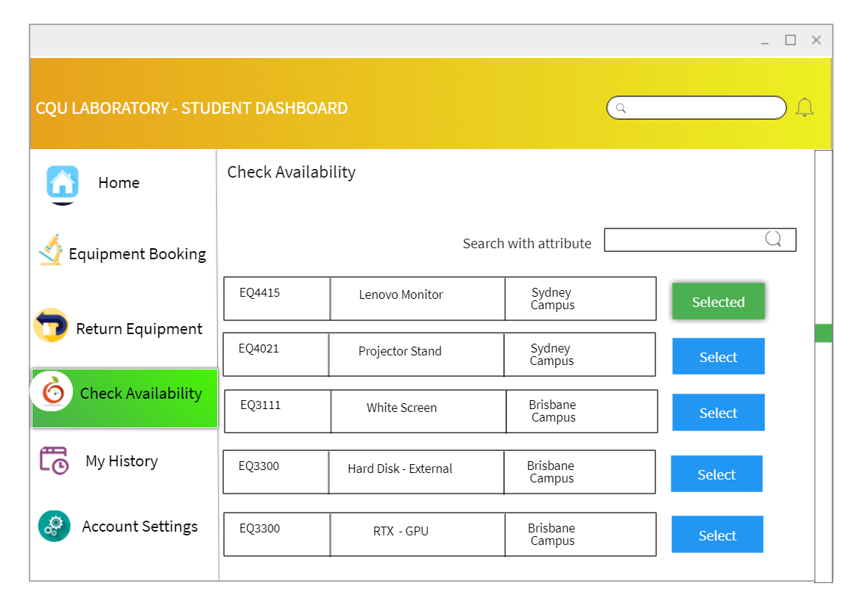
USER INTERFACE DESIGN – CHECK AVAILABILITY

Slide 19
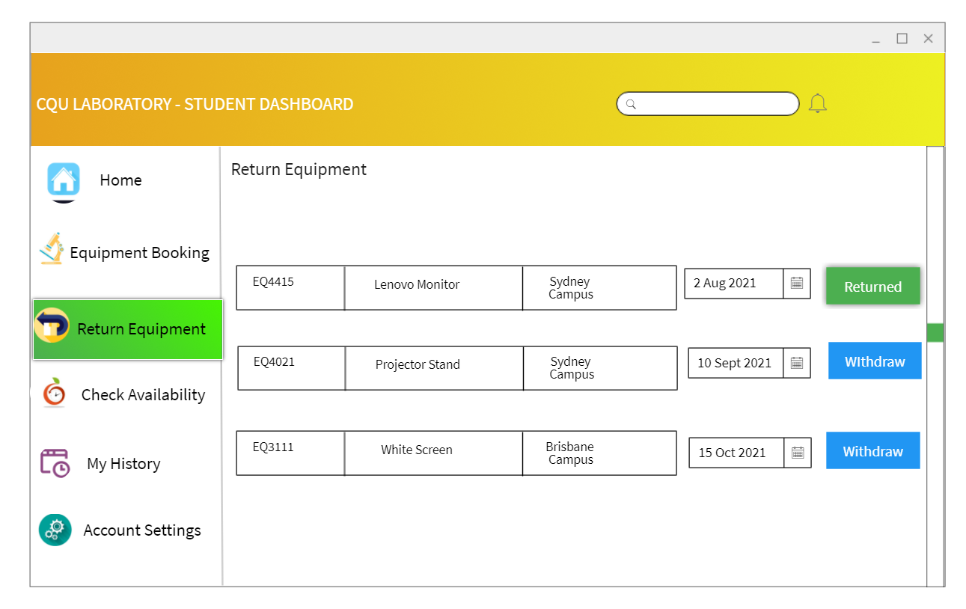
USER INTERFACE DESIGN – CHECK AVAILABILITY

Slide 20
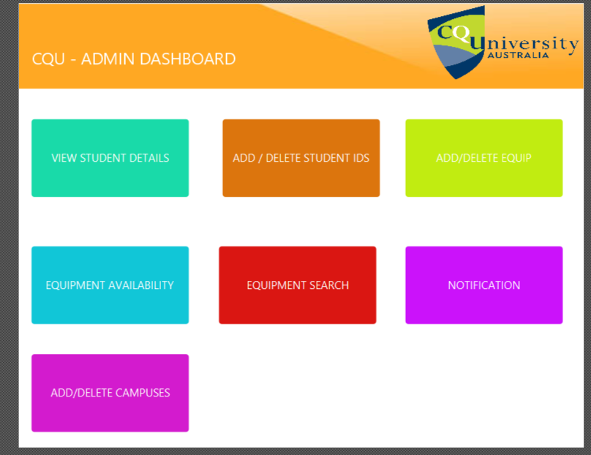
USER INTERFACE DESIGN – ADMIN DASHBOARD

Slide 21
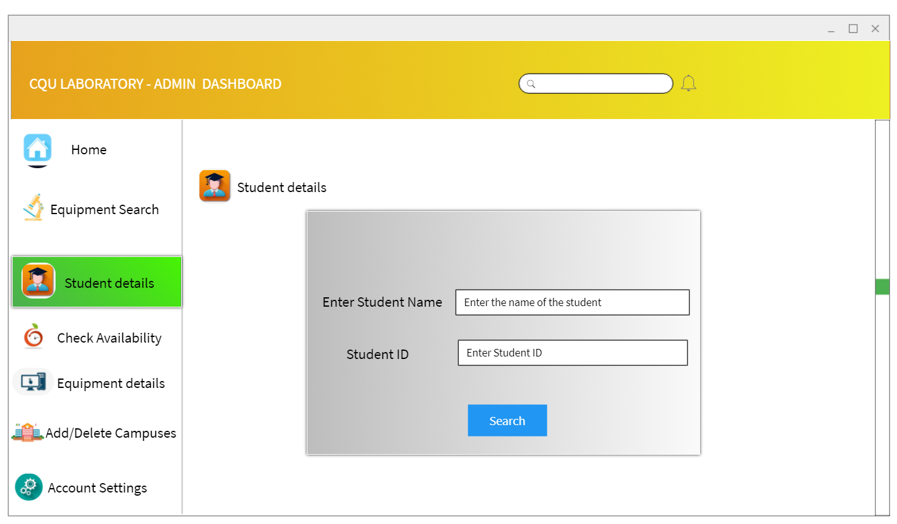
USER INTERFACE DESIGN – STUDENT SEARCH

Slide 22
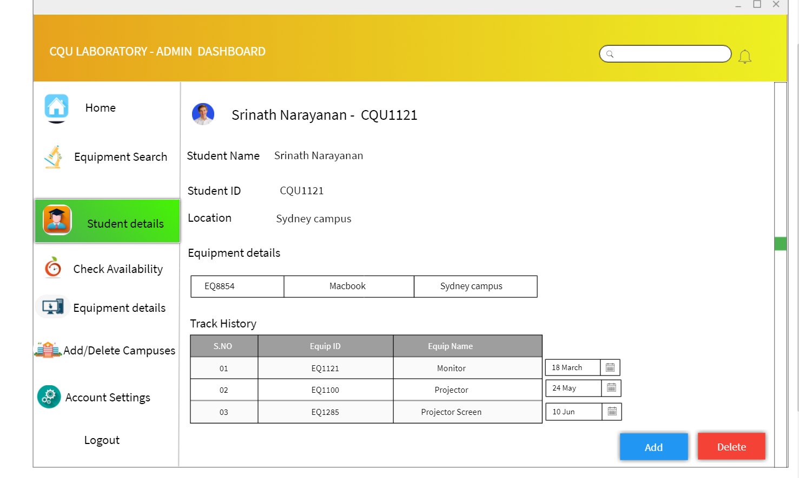
USER INTERFACE DESIGN – ADD / DELETE STUDENT DETAILS

Slide 23
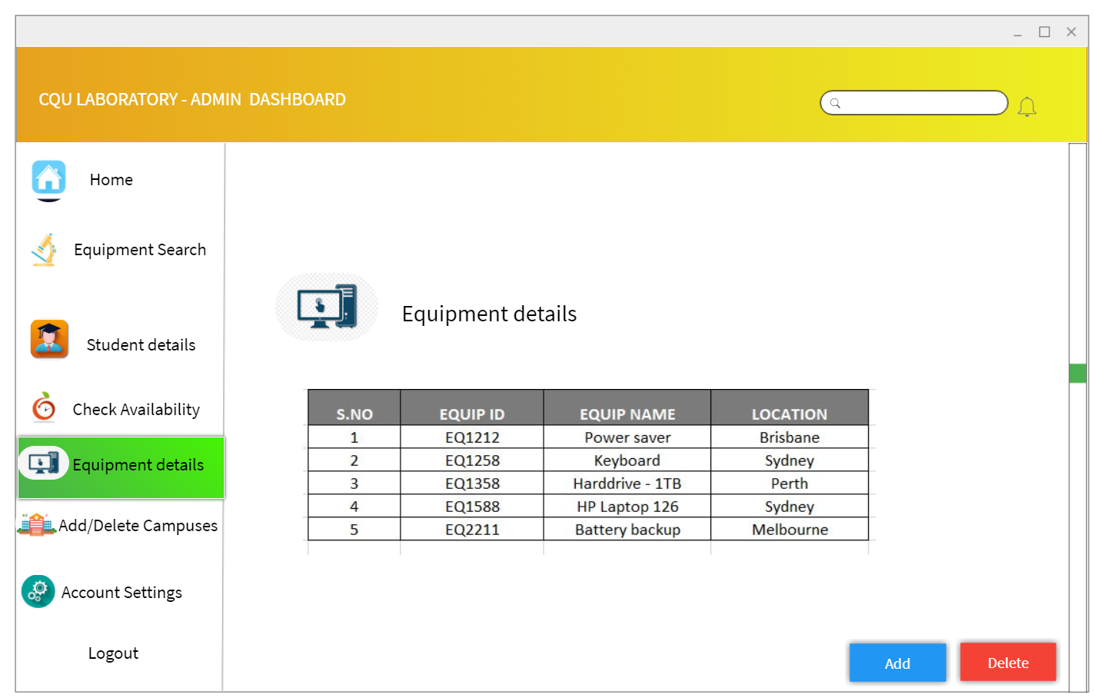
USER INTERFACE DESIGN – ADD / DELETE EQUIPMENT DETAILS

Slide 24
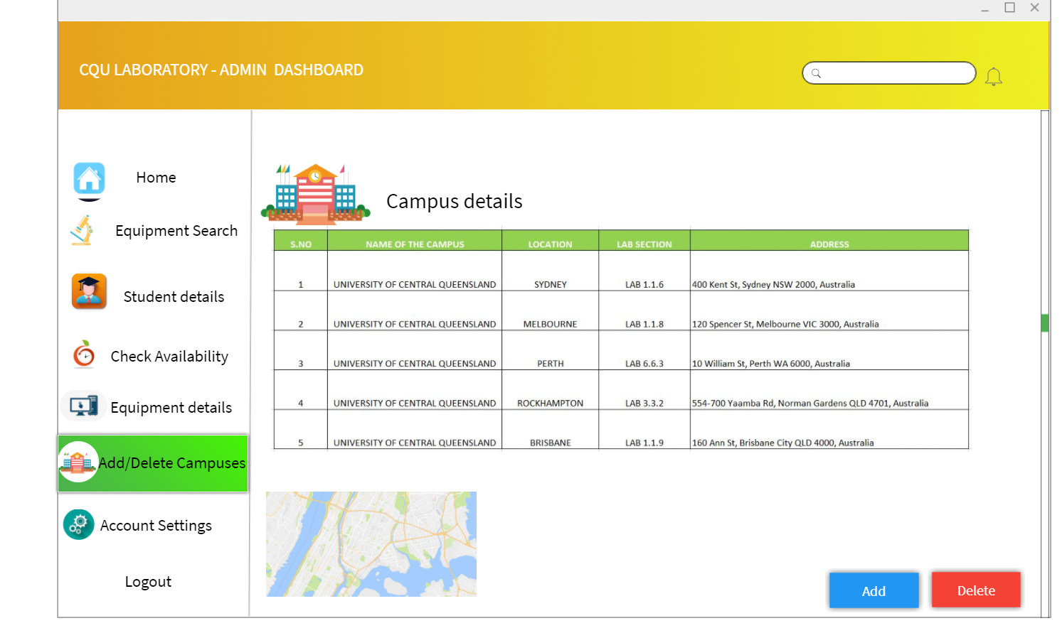
USER INTERFACE DESIGN – ADD / DELETE CAMPUS DETAILS

Slide 25
WHAT WE DONE IN THIS DESIGN WINDOW
We done with UML diagrams – Process flow, Sequence diagrams, Class diagrams and ERD diagrams
We also created the prototype design for User interface – For both Admin and lab member dashboard.

Slide 26
YOUTUBE LINK
https://www.youtube.com/watch?v=awhkxtKoYrE

Slide 27
Thank You

